Slide 1
CELEBRITY VOTING DAPP

Slide 2
PROBLEM STATEMENT
The entertainment industry thrives on fan engagement and the popularity of celebrities. Traditional voting systems used for celebrity awards, reality show outcomes, and fan-favorite selections often face issues such as lack of transparency, potential for vote manipulation, and limited accessibility. With the advent of blockchain technology, there is a potential to revolutionize this voting process by creating a decentralized application (DApp) that ensures transparency, security, and inclusivity.

Slide 3
TECHNOLOGIES USED
CASPER WALLET, RUST, REACT, JAVASCRIPT, NODE.JS

Slide 4
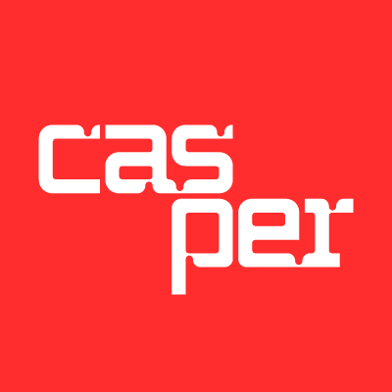
CASPER WALLET
Casper Wallet is a digital wallet designed to interact with the Casper blockchain, providing users with a secure and user-friendly way to manage their Casper (CSPR) tokens and other digital assets. It supports functionalities like sending and receiving tokens, viewing transaction history, and interacting with decentralized applications (DApps) built on the Casper network. The wallet ensures security through cryptographic keys and offers features such as multi-signature support and hardware wallet integration for enhanced protection

Slide 5
CASPER WALLET
Key Features:
Security: Utilizes advanced encryption techniques to protect user funds and data.
User Interface: Designed for ease of use, ensuring that even non-technical users can navigate and manage their assets effectively.
Integration: Seamlessly integrates with Casper-based DApps, allowing users to participate in activities like voting directly from their wallet.

Slide 6

RUST
Rust is a systems programming language known for its performance, reliability, and safety. It is particularly well-suited for building the backend of blockchain applications due to its ability to handle concurrent tasks efficiently and its emphasis on memory safety without a garbage collector.

Slide 7
RUST
Key Features:
Performance: Compiles to native code, offering performance comparable to C and C++.
Memory Safety: Prevents null pointer dereferencing and buffer overflows, common issues in other low-level languages.
Concurrency: Provides powerful concurrency primitives, enabling efficient parallel processing.
Usage in DApp:
Rust is used to develop smart contracts on the Casper blockchain, ensuring they are robust, secure, and efficient. It is also used for backend components that require high performance and low-level control.

Slide 8
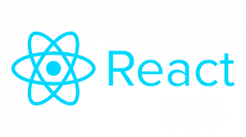
REACT
React is a JavaScript library for building user interfaces, particularly single-page applications where dynamic data rendering is crucial. Developed and maintained by Facebook, React allows developers to create reusable UI components, enhancing code maintainability and development speed.

Slide 9
REACT
Key Features:
Component-Based Architecture: Enables the development of encapsulated components that manage their own state, which can be composed to build complex UIs.
Virtual DOM: Optimizes rendering by diffing changes and updating the real DOM only when necessary, improving performance.
Declarative Syntax: Makes the code more predictable and easier to debug
Usage in Dapp:
→ React is used to build the front-end of the voting application, providing a responsive and interactive user interface for voters. It handles the display of voting options, real-time updates of voting results, and user interactions with the DApp.

Slide 10

JAVASCRIPT
JavaScript is a high-level, interpreted programming language widely used for web development. It allows for the creation of dynamic and interactive web pages. JavaScript can be run on both the client side (in the browser) and the server side (using Node.js).

Slide 11
JAVASCRIPT
Key Features:
Versatility: Can be used for both front-end and back-end development.
Event-Driven: Excellent for handling asynchronous operations, such as user interactions and API calls.
Large Ecosystem: A vast array of libraries and frameworks that accelerate development.
Usage in DApp:
→ JavaScript is employed in various parts of the application, including client-side scripting for dynamic content updates and server-side logic using Node.js to handle API requests and interact with the blockchain.

Slide 12

NODE JS
Node.js is a runtime environment that allows developers to execute JavaScript code on the server side. Built on Chrome's V8 JavaScript engine, Node.js is designed for building scalable network applications.

Slide 13
NODE JS
Key Features:
Asynchronous and Event-Driven: Optimized for handling multiple I/O operations efficiently.
Non-Blocking I/O: Improves performance by allowing the server to process other requests while waiting for I/O operations to complete.
NPM (Node Package Manager): Provides access to thousands of libraries and tools, facilitating rapid development.
Usage in DApp:
→ Node.js is used to build the backend server that interacts with the blockchain. It handles API endpoints, processes user requests, manages the voting logic, and communicates with the Casper blockchain to fetch and submit data.

